Slide 1
Cloud Fundamentals - AWS
Lokesh Shukla

Slide 2
Local Development & AWS Development
Local Development
Everything runs locally on same machine
Files stored on server
Database on same server as application
Connections done manually
AWS Development
One service = One responsibility
Files served from S3
Database as a Service
Connections done with AWS SDK

Slide 3
AWS Management Console
Configure & create resources
Each service has its own dashboard
Dashboards are similar to each other

Slide 4
AWS CLI and SDK
AWS Access Key gives access for SDK and CLI

Slide 5
IAM and Cloud Watch

Slide 6
CloudWatch
Set Alarms and Notifications in Response to Events
IAM
Simple User and Access Management

Slide 7
CloudWatch
Service to set alarms based on service metric thresholds.

Slide 8
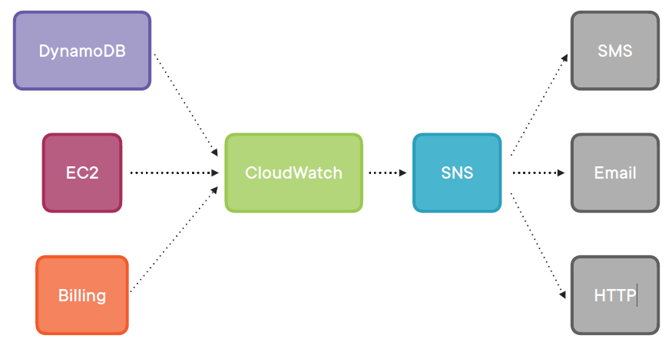

Slide 9
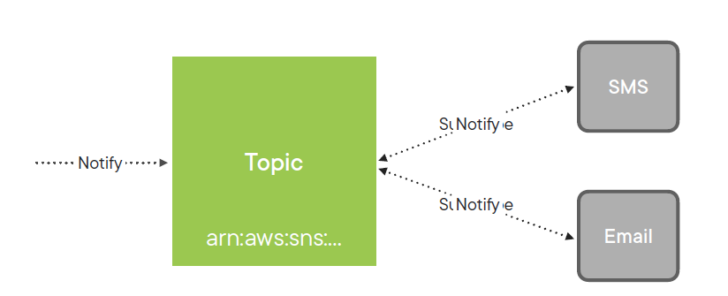
Simple Notification Services

Slide 10
Cloud Watch Alarm

Slide 11
Billing Alerts are only enabled in the North Virginia region
Billing alerts are only enabled in the North Virginia region

Slide 12
Identity and Access Management (IAM) Service to configure authentication and access for user accounts.

Slide 13
Root Account Permissions
Administer all services
Modify billing information
Manage users

Slide 14
Multi-factor Authentication Authentication that requires more than one factor to authenticate.

Slide 15
Policy Statement Properties
Effect “Allow” or “Deny”
Action Operation user can perform on services
Resource Specific resources user can perform action on

Slide 16
IAM Policy Types
AWS Managed Policy
Customer Managed Policy
Use policies to give permissions
Create Users and Groups

Slide 17
Elastic Compute Cloud Virtual machine service that runs software of your choice.

Slide 18
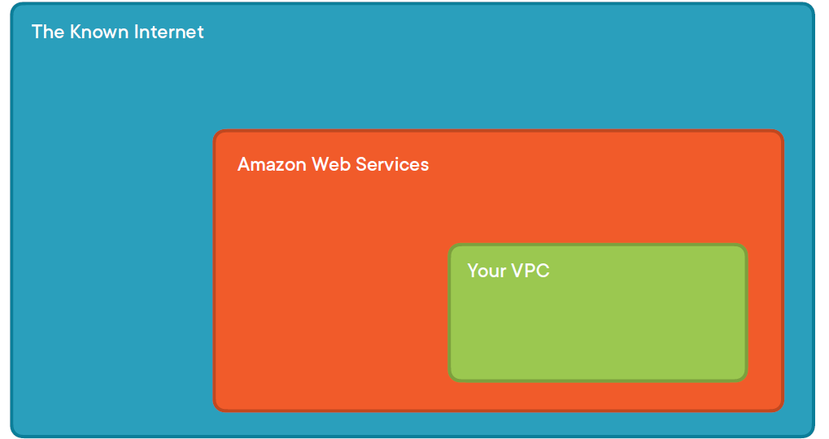

Slide 19
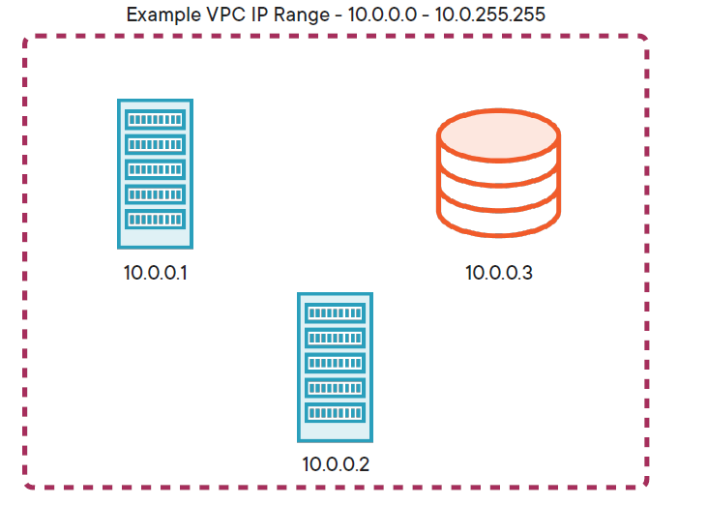

Slide 20
Security Group Defines allowed incoming/outgoing IP addresses and ports. Kind of like a mini-firewall

Slide 21
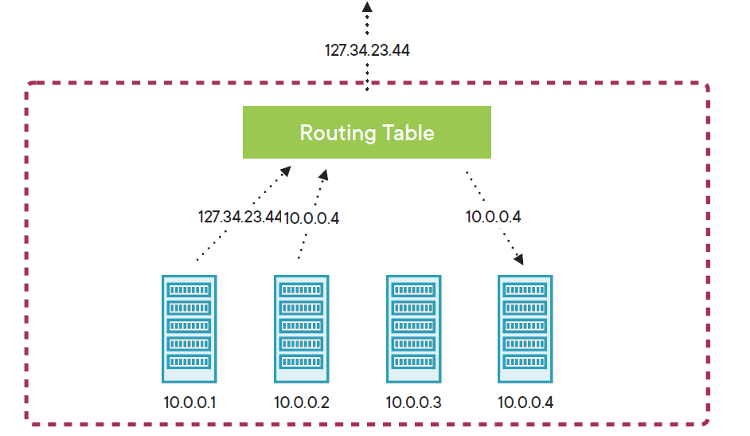

Slide 22
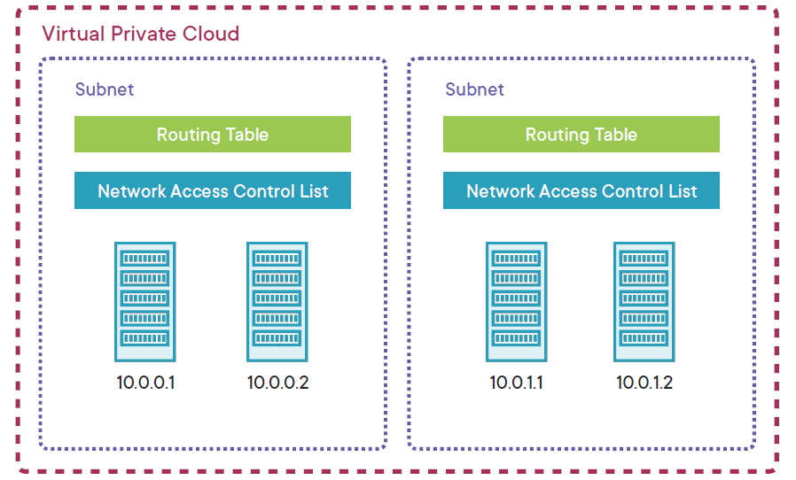

Slide 23
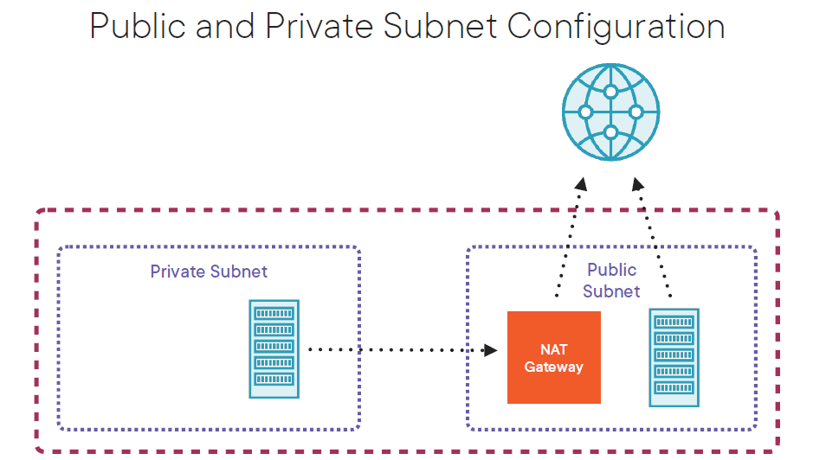

Slide 24
Elastic Cloud Compute (EC2)

Slide 25
Amazon Machine Image (AMI) Operating system and software installed on an EC2 instance.

Slide 26
EC2 Instance Types
General purpose
Compute optimized
Memory optimized
Storage optimized

Slide 27
Elastic Block Store Independent storage volumes used with EC2 instances

Slide 28
Elastic IP Public IP addresses that are created, destroyed, and assigned independently.

Slide 29
With custom AMIs, an EC2 instance can be saved as a snapshot and replicated

Slide 30
Auto Scaling Group Expands or shrinks a pool of instances based on pre-defined rules.

Slide 31
Load Balancer Routing appliance that maintains a consistent DNS entry and balances requests to multiple instances.

Slide 32
Simple Storage Service AWS service for storing files. S3 stores Objects in the Region you specify The maximum object size in S3 is 5 terabytes

Slide 33
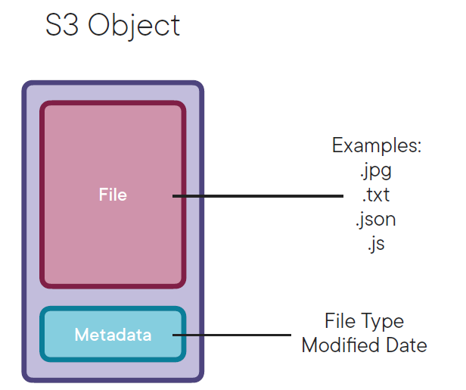

Slide 34
S3 Object Key Example
Filename: image.png
Folder Name: images
Object Key: images/image.png

Slide 35
Relational Database Service Managed database instances in AWS running on EC2.

Slide 36
RDS Managed Task Examples
Software upgrades
Nightly database backups
Monitoring

Slide 37
RDS Backups
Occurs daily
Configurable backup window
Backups stored 1 - 35 days
Restore database from backup

Slide 38
Multi-AZ Deployment
Database replication to different Availability Zone
Automatic failover in case of catastrophic event

Slide 39
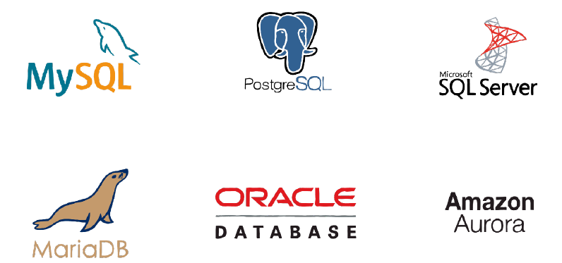
RDS Database Options

Slide 40
Database Services in AWS
RDS
DynamoDB
Relational SQL
Non-relational NoSQL

Slide 41
CloudFormation Service to provision resources using templates.

Slide 42
Cloud Formation Templates
JSON document
Contains configuration for resources
Can be used in version control
No limit to amount of resources

Slide 43
Elastic Beanstalk
Scaling
Monitoring
Resource provisioning

Slide 44
CloudFormation
Elastic Beanstalk
Only provisions resources
Provisions resources and runs your application

Slide 45
Elastic Beanstalk Application
Represents a logical application
Runs a single platform (eg. Node.js, Java)
Has one or more application versions

Slide 46
Application Deployment Steps
Manual
Elastic Beanstalk
Upload new code to EC2 instance
Create AMI
Update launch template
Update Auto Scaling Group
Terminate out-of-date instances
Upload new code

Slide 47
Kinesis Streams – An Overview

